Slide 1

Engaging in policy processes on climate change
Introduction to the global climate agenda

Slide 2
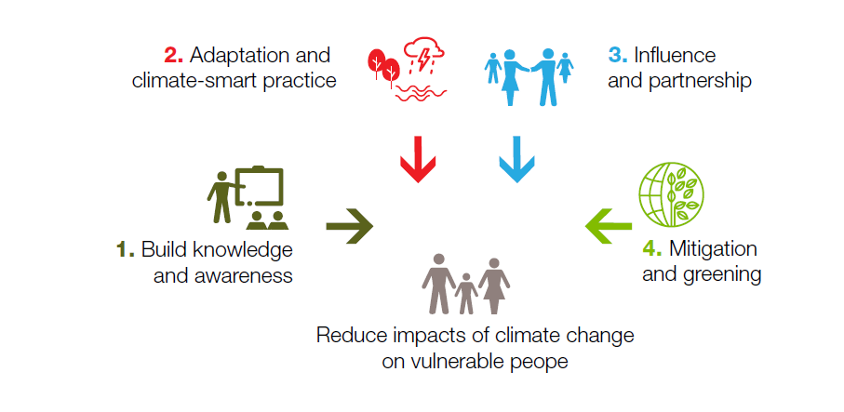
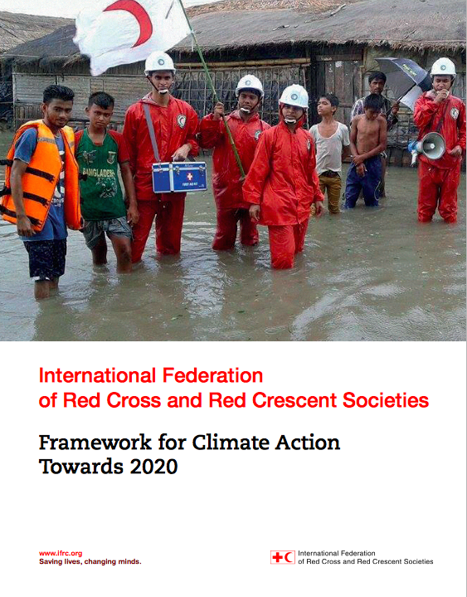
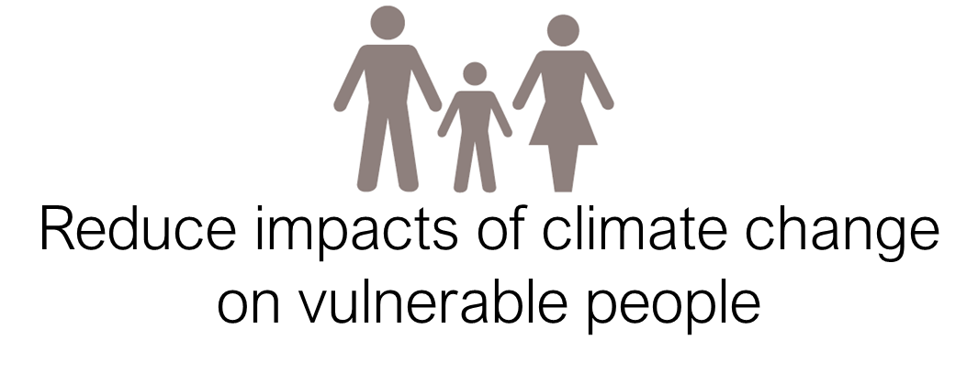
In this presentation…
…why international policy developments on climate change are important for national and sub-national dialogues with your partners
To discuss
Why should we contribute to climate-related policy processes and dialogues?
What is the relationship between climate-smart policy and practice, and how do they influence each other?
Notes:
Policy dialogue – advocacy or humanitarian diplomacy – is necessary as we believe many international commitments made by governments are not yet implemented nationally or locally, or in a way that builds the resilience of the most vulnerable people.
Our aims on the policy dialogues are fully aligned with the IFRC Framework for Climate Action towards 2020 to create a policy environment conducive to harnessing the collective action of the Red Cross Red Crescent Movement and its partners.
As illustrated all the efforts in capacity building, climate-smart practice, partnerships and 'greening' is aimed at reducing the impact on vulnerable people.

Slide 3

Overview of session
What we seek to achieve through engagement in climate-related policy processes
RCRC key messages or “policy asks”
The Paris Agreement: what is it and why does it matter for our work?
Global to local: connecting global processes to our national engagement, drawing on local needs and perspectives
- 'National Adaptation Plans' and climate laws

Slide 4

Our volunteers are standing on the front line and are witnessing how climate risks are disproportionately affecting the most vulnerable communities in the world
We need to bring this knowledge to the attention of the decision makers
The key reason for policy dialogue

Slide 5
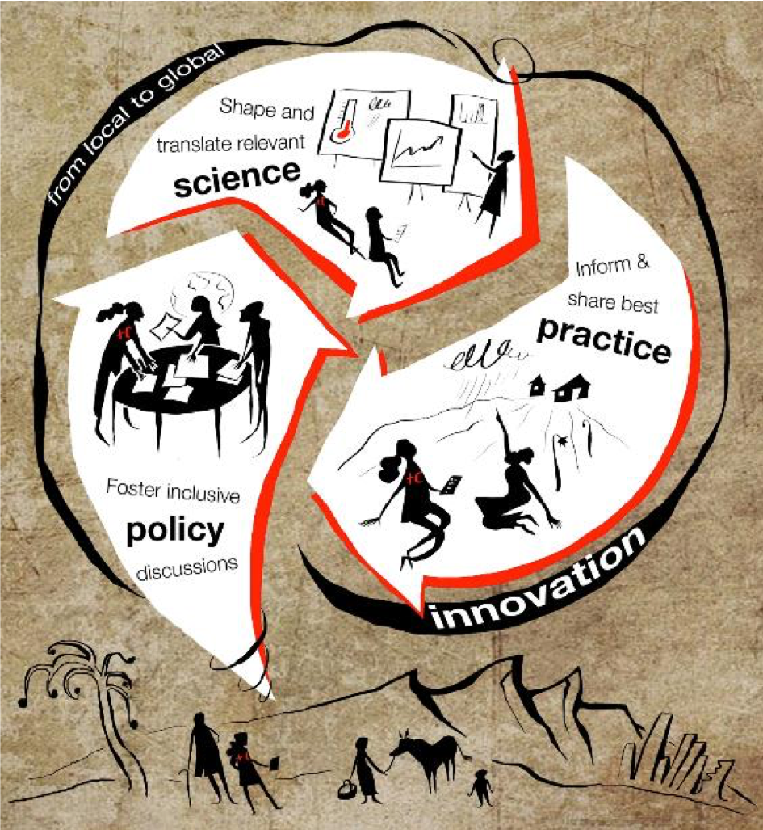
Notes:
Dialogues are to be informed by practice and science. We are uniquely positioned in the Red Cross to bring strong messages on the needs of the most vulnerable, including practice examples of climate-smart DRR to the forefront of policy discussions. For climate change, we also have enough science at hand, and are collaborating with HydroMet offices to partner in these dialogues to promote strong and urgent climate action.
The needs of the most vulnerable are most effectively addressed when planning is informed by the latest climate science and policies are translated into actionable plans. We need to integrate knowledge and know-how across the realms of policy, practice and science, which is more urgent than ever.

Slide 6


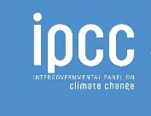
First some terminology:
UNFCCC: United National Framework Convention on Climate Change; a global treaty that aims at preventing dangerous levels of climate change. UNFCCC have a number of working groups.
COP: Conference of Parties; UNFCCC Conference of the Parties (COP) is the annual meeting of all states that are members ("parties") to the UNFCCC. At the COP in 2015, world leaders reached the Paris Agreement (see later).
IPCC: Intergovernmental Panel on Climate Change; is the international body providing policymakers with regular assessments of the scientific basis of climate change, its impacts and future risks, and options for adaptation and mitigation.
… more later
Notes:
UNFCCC: United National Framework Convention on Climate Change; A global treaty that aims at preventing dangerous levels of climate change. Countries party to the treaty meet annually in the global climate change conference to negotiate modalities of limiting GHG and coping with the impact of unavoidable changes in the climate.
COP: Conference of Parties; The United Nations Framework Convention on Climate Change (UNFCCC) Conference of the Parties (COP) is the annual meeting of all states that are members ("parties") to the UNFCCC. The parties discuss progress on the many decisions taken since 1995 at these annual meetings and negotiate future decisions to reduce the risks of climate change. The most significant step was the Paris Agreemtn (2015) – see later in this session.
IPCC: Intergovernmental Panel on Climate Change; their regular assessments – compiled by thousands of scientists who synthesises and conclude on the basis of existing scince at the time (they do not produce new science) - provide a scientific basis for governments at all levels to develop climate-related policies, and they underlie negotiations at the (UNFCCC). The assessments are policy-relevant but not policy-prescriptive: they may present projections of future climate change based on different scenarios and the risks that climate change poses and discuss the implications of response options, but they do not tell policymakers what actions to take
See more in IPCC Factsheet: http://www.ipcc.ch/news_and_events/docs/factsheets/FS_what_ipcc.pdf
In other parts of this module, more definitions will be inftroduced

Slide 7

Framework for Climate Action Area of Work 3: Influence and partner to increase our impact
The Framework defines success as: National Societies and the IFRC are able to successfully influence climate related laws, policies, plans and investments to prioritize the needs of the most vulnerable, and are increasingly recognized and consulted in this role. New partnerships are established with organizations and networks that strengthen our work and visibility in addressing climate change
Global Level – UNFCCC (COPs, Loss & Damage, Adaptation Committee, etc.),
Regional level – regional organizations, frameworks (e.g. Pacific Resilience Framework, Asian Ministerial Conference on Disaster Risk Reduction)
National level – National Adaptation Plans, laws, policies, proposals/projects
Notes:
As mentioned, the IFRC Framework for Climate Action sets as our second area of work “Influence and partner to increase our impact”. This means working at various levels to influence, connect and partner.
At the global level, the Movement – typically via IFRC, Climate Centre and some National Societies - is active in relation to the annual 'COPs' but also in the working groups working in-between the annual COPs, for example, in regular session of the Adaptation Committee.
Similarly at the regional level, the Movement typically engages to promote resilience and climate at the events like the biannual Asian Ministerial Conference on Disaster Risk Reduction.
At national level, Several National Societies are active in dialogue with partners and government to support National Adaptation Plans (see separate presentation) and other relevant policies.

Slide 8
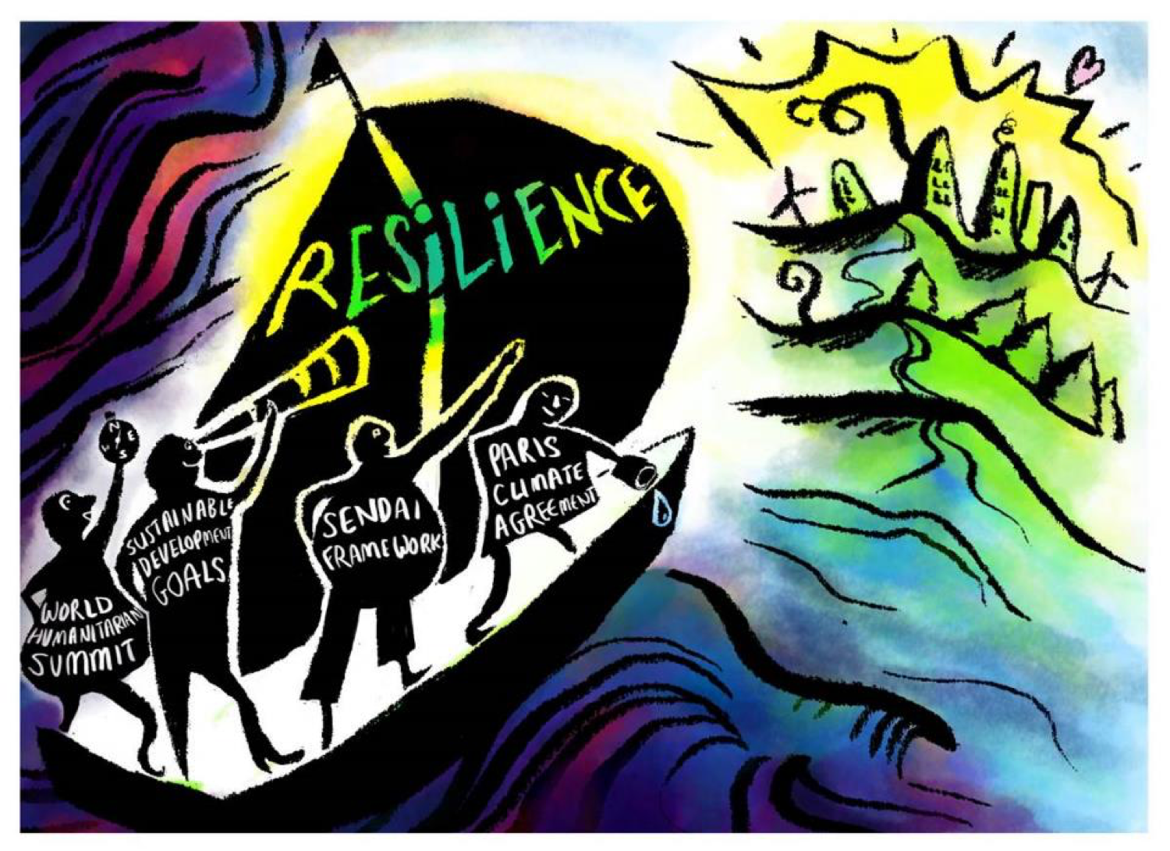
Notes:
But the Movement is also active in promoting the climate and resilience agenda in relation to the implementation of other global agreements in the UN system.
Especially relevant for the Red Cross Red Crescent Movement is the clear overlap between the adaptation components of the four global frameworks – they combine to build resilience:
The Paris Agreement on Climate Change
the Sustainable Development Goal (SDG)
The Sendai Framework for Disaster Risk Reduction
The World Humanitarian Summit
Increasing attention towards the localization of aid has shifted the global discourse towards areas more closely aligned with the community-based work of National Societies, with a burgeoning focus on climate change adaptation, climate-smart disaster risk reduction, climate risk management, and climate resilience.
Linking these frameworks to national planning processes is a major opportunity for the Red Cross Red Crescent to help ensure that these efforts contribute to forging an inclusive and transformative sustainable development agenda for 2030 and beyond.
Message on coherence is important for us. We see the most important international agreements, which need to be aligned and coherent in its implementation by the humanitarian sector. Resilience is a concept which we bring into the various implementation plans of these international agreements at national and local level. (EXPLAIN WHY/HOW?)
Coherence in implementation of the international frameworks is key (WHY? Provide example) and it is be important to let Governments know how this can be done. We need to avoid isolated pillars for policy planning in different ministries and sectors. We are to ensure that Ministries and sectors have enough collaboration, learning and cross referencing in policies and laws for development, spatial, DRR, climate, heatlh, agriculture and land use policy planning. (GIVE EXAMPLE of where a NS has successfully done this)

Slide 9
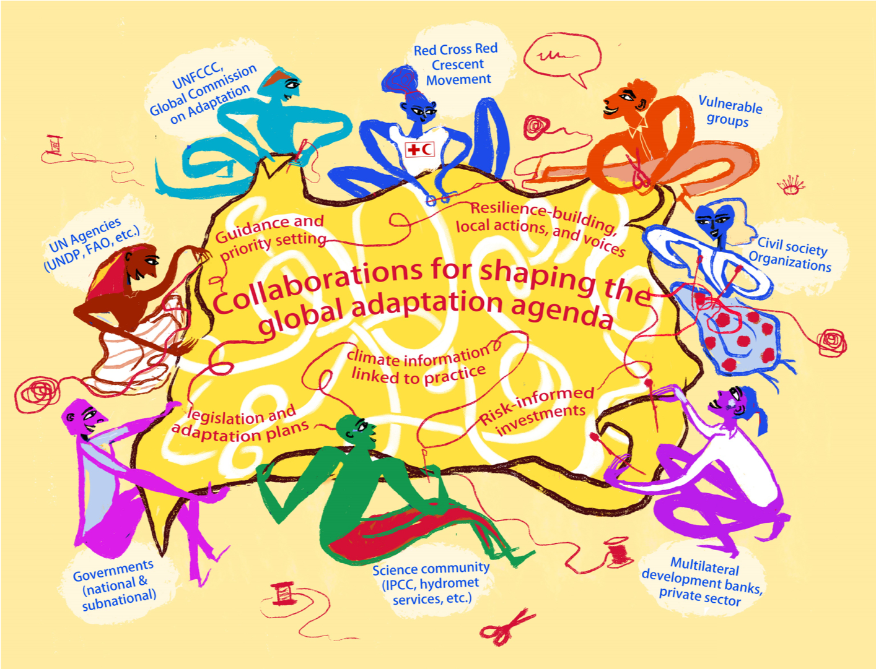
The Red Cross Red Crescent is not working on this in isolation
Notes:
The Red Cross Red Crescent is not working on this in isolation
Climate change is a cross cutting issue that affects many sectors and organisations, much is going on in the International arena to work out how best to reduce greenhouse gas emissions, who will pay for adapting to climate change and what can be done to reduce the impacts. At the national level it is also a similar story in that it involves many different sectors and organisations. At all levels, it is possible for Red Cross Red Crescent to engage on the topic of climate change adaptation with an important aim: firstly to ensure that climate change funding reaches the most vulnerable, and secondly for Red Cross Red Crescent Movement to show that it can assist in addressing the humanitarian implications of climate change. Therefore, it is important to keep briefed on current developments on climate change, and adaptation at all levels that Red Cross Red Crescent works at. Funding mechanisms, relevant international policies and latest science can all influence how we can address climate change within the Movement.
Key stakeholders are:
UNFCCC
IPCC
Global Commission on Adaptation
Multilateral Development Banks
(Sub) National Governments
Hydro Met agencies
Knowledge Centra and Academia
CSOs and vulnerable groups

Slide 10
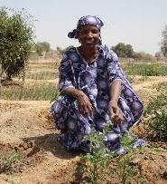
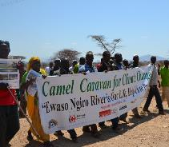
Successful engagements in climate policy and planning processes:
Result in changes in policy documents, decisions, and ways of working in the interests of the most vulnerable people
Draw on Red Cross Red Crescent Movement and experience (e.g. from DRR or resilience projets) to influence policy and planning
Build partnerships and coalitions, and facilitate local voices being heard, bringing coherence across humanitarian, development and climate agendas
Utilize innovation to enhance impact, influence and sustainability
Notes:
1. Draw on Red Cross Red Crescent Movement and experience: our presence from local to global levels and connections between local, national, regional and global policy and financing systems uniquely position us to link top-down and bottom-up processes related to policy, practice and science. Through our community networks around the world, we have a solid understanding of the differences and commonalities in local risks, and of locally-driven solutions to build resilience. National Societies have ample experience on climate-smart DRR and resilience programmes, which allows us to position ourselves as support for governments seeking to merge the UN SDGs with Nationally Determined Contributions and Sendai targets. At the global level, we lobby and advocate for policies to be translatable to action on the ground and focused on meeting the needs of the most vulnerable.
2. Build partnerships and coalitions facilitate convenings for achieving policy impact: The Climate Centre enables the Red Cross Red Crescent Movement and its partners to leverage technical support, bridging gaps and bringing coherence to the implementation of humanitarian, development and climate strategies from the local to global level. We create platforms where decision-makers and thought leaders from the practitioner and research communities gain access to influence policy making based on a sound evidence base. We broker interactions between groups that may not typically speak to one another to come together and spearhead new efforts to build the resilience of the most vulnerable to the impacts of climate change.
3. Advocate: Our advocacy messages focus on promoting more integrated climate action at scale; supporting climate-smart disaster risk reduction and development planning; strengthening capacities of local partners to enable meaningful participation in national and international policy dialogues; ensuring climate finance reaches the most vulnerable people (and not just the most vulnerable countries or sectors) including particularly vulnerable groups such as women and children; expanding inclusion of those with lived experience on the frontlines of climate change in climate-related decision making processes.
4. Communicate: we use the Red Cross Red Crescent platform to communicate on behalf of the most vulnerable. Our policy activities address two main audiences: 1) the Red Cross Red Crescent Movement, whom we support to advance relevant policy issues in their national and local contexts; and 2) external partners who will better understand the humanitarian implications of climate change, in order to further advance our policy aims through a wider scope of champions.
5. Learn and Manage Knowledge: As a boundary organization spanning science, policy, and practice, the Climate Centre strives to strengthen the capture and dissemination of learning within and among these constituencies, identifying what works well and not so well to inform holistic, evidence-based, fit-for-future policy recommendations.
6. Innovate for greater impact: We seek to pilot new innovations for enhanced policy dialogue, and to scale successful experience up and outwards. Development & Climate Days held at COPs are an example of how our innovative approaches facilitate incisive and meaningful policy-related dialogue.
7. Mobilize resources: the Climate Centre seeks to ensure continued funding beyond 2020 to advance our vision more broadly across new and diverse geographies as well as more deeply within identified as well as emerging thematic priority areas. Resources are also to be channeled to support working with wider constituencies on adopting and adapting of existing innovations for enhanced policy dialogue as well as for pioneering new innovative approaches on the policy and practice front.

Slide 11

RCRC key climate-related policy messages
Notes:
Optional slides on some of our key policy messages
This – and the next 3 slides – can be 'hidden' if you as facilitator do not want to go into these details.

Slide 12
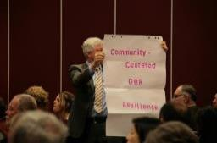
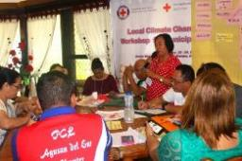
Key climate-related policy messages for the Red Cross and Red Crescent
#1: Ensure that policies prioritise the most vulnerable people – ensuring that within global, national and local decisions and plans the needs of the most vulnerable people to climate change are met
#2: Increase attention and finance for adaptation and resilience, in order to strike a balance with the commitments for mitigation
#3: Ensure the role of local actors in climate action is enabled, including through promoting decentralised access to climate finance; and to invest in risk reduction at local levels, with an eye on the most vulnerable, involving local stakeholders in the process (e.g. Mayors, grass-root organizations, CSOs, women groups, youth)
Example: Philippines Red Cross has been leading a community bottom-up process, developing 'local climate change adaptation plans' (LCCAP) in areas where they have strong Branches; the LCCAP guides spending from the national Climate Change Commission
Notes:
Optional slides on some of our key policy messages
As auxilliary to government, the Red Cross Red Crescent Movement brings coherence with common key messages on climate variability and change, to inform improved approaches to climate risk management. As stated in the IFRC Framework for Climate Action towards 2017, we call on governments and key stakeholders to realize the following four key policy asks.
The example: see further in this news piece: https://www.climatecentre.org/news/842/planning-climate-action-in-the-philippines-the-local-way

Slide 13
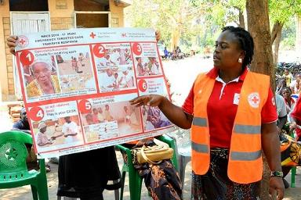
Key climate-related policy messages for the Red Cross and Red Crescent
#4: Implement integrated risk management for building climate resilience, bringing together humanitarian, development, and climate change responsibilities from local to national level
Example – social protection: Most national governments use social protection (SP) programmes to protect poor and vulnerable groups. Resilience policy frameworks can link with national social protection programmes as a platform for adaptive interventions
In 2017, the Malawi Government revised the national social protection policy programme.
The Malawi Red Cross and partners participated in the policy review process and focused on improving climate-sensitive SP and aligning it with humanitarian action
As a result, climate-sensitive social protection became a national priority, and efforts will be taken forward in a more coherent and impactful way
Malawi Red Cross will continue to be engaged in the delivery and implementation of the national cash transfer program, which will now have stronger linkages with humanitarian response
Photo: Felix Washon/IFRC
Notes:
Optional slides on some of our key policy messages
See more information at this news piece: https://www.climatecentre.org/news/943/social-protection-thata-s-sensitive-to-shocks-a-a-national-prioritya-in-malawi
And also, more details on the process:
In September 2017, the Government finalised the revised Malawi National Social Support Programme II (MNSSP II), which sets out the strategic vision and objectives for the provision of social support in Malawi from 2017 to 2022. This document was developed with input from the ECHO partners (which included the Malawi Red Cross alongside Concern Worldwide and COOPI), who participated in the review and development process and contributed in particular to the development of the focus on Shock-Sensitive Social Protection in MNSSP II.
The ECHO partners’ input to the MNSSP II process was informed by a Joint ECHO Partners strategy document which set out a wide and comprehensive vision for the Social Protection Programme in Malawi, with a set of proposed short, medium and longer-term outcomes under 6 priority areas.
The MNSSP II has a clear set of thematic priorities, which includes Shock Sensitive Social Protection.

Slide 14
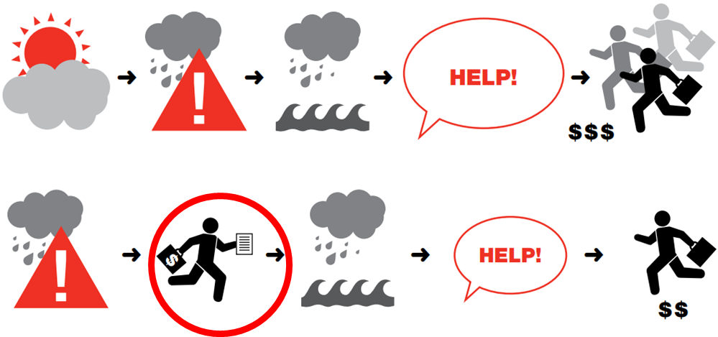
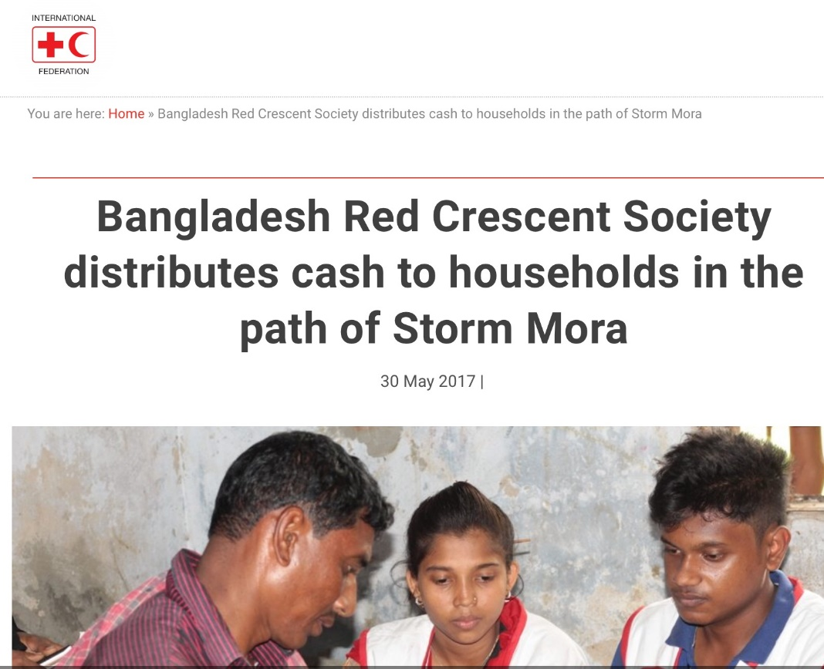
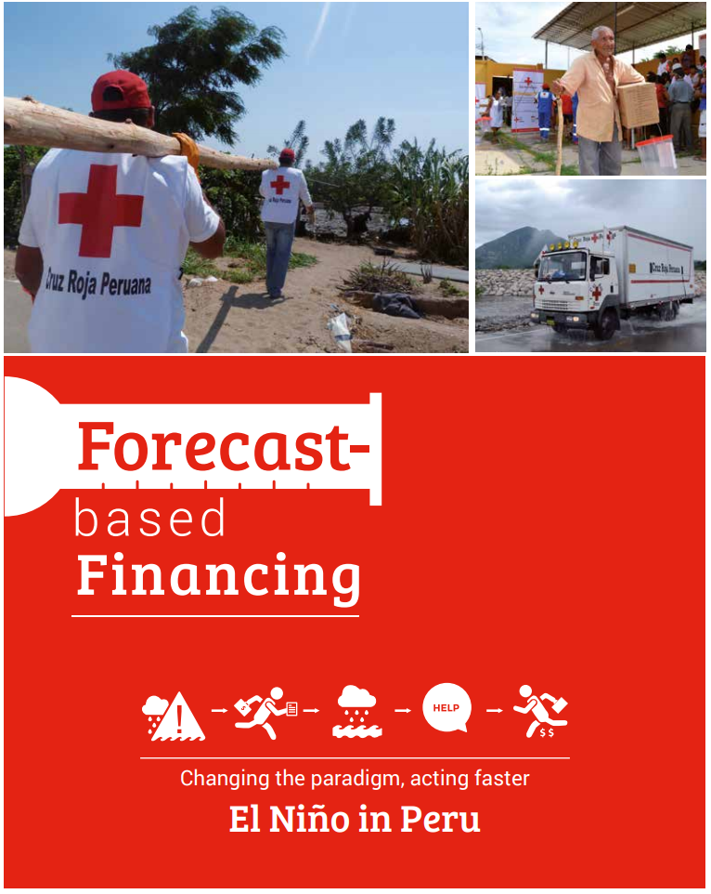
Key climate-related policy messages for the Red Cross and Red Crescent
#5: It is essential to make better use of climate information across all timescales for proper early warning early action – and for appropriate finance for early action
Example: The Forecast-based financing approach – piloted by Red Cross Red Crescent and in some UN agencies in several countries – is a very specific example of linking forecasts to early action.
Notes:
Optional slides on some of our key policy messages
See Module 2a for special presentations and exercises on Forecast-based Financing (FbF).
See this news piece for links to more in-depth information on FbF: https://www.climatecentre.org/programmes-engagement/forecast-based-financing
Case study on FbF in Peru:
http://climatecentre.org/downloads/files/NotaTecnicaFEN%20-%20Ingles%2020set2016.pdf

Slide 15
The Paris Agreement – a global framework
Notes:
Depending on the audience, time – and facilitator skills and comfort zone - you as facilitator may consider using some of the questions below during the session (not necessarily at this particular slide) :
#1: Has your NS participated at COP? If so - what was one major disappointment in this engagement and what was one major highlight?
#2: Has your NS actively discussed climate change issues with your Government/representative throughout the years? If yes, what was the most exiting result?
#3: Do you think your NS will engage in the short term with your Government to engage on NDCs or NAPs?
#4: Have you considered making a pledge with your government on climate change at the International Conference?
#5: Has your NS in past 10 year been involved in climate change related programming/ resilience programming (with climate focus)? What has been your most successful experience with climate change related programming?
#6: Has your NS been involved in NAP dialogues?

Slide 16


A few insights from the Paris Agreement
A strong long-term goal on emissions and global temperatures
Agreement to keep the increase in global average temperature to well below 2ºC (but with efforts to limit to 1.5ºC)
Aim for greenhous gas emissions to peak as soon as possible
In the long-term: towards zero (net) emissions
Photo: Climate Centre
Notes:
Explain:
UNFCCC as climate change architecture
Yearly COPs (2015: Paris; 2017: Bonn; 2018: Katowice; 2019 Chile )
Myriad standing bodies and working groups, but three main pillars: Mitigation, Adaptation, Loss and Damage.
Paris can be seen as a major stepping stone. It shows the commitment, which is favourable for transitions towards green development. It is however not enough to ensure we can limit disastrous climate change scenarios in the future. More on this in the next slide.
Green Climate Fund
Nationally Determined Contributions
Strong mitigation goal:

Slide 17
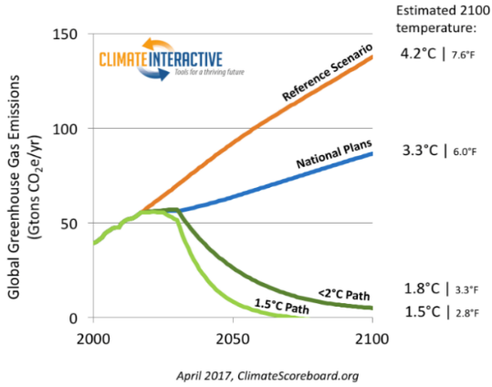
A few insights from the Paris Agreement
– but insufficient concrete commitments
Business as usual
Current NDC commitments
2ºC= DANGER
Notes:
The current commitments in the NDCs are not enough to keep warming below 2 degrees
189 intended NDCs covers countries emitting 95% of global emissions, i.e. remarkable level of participation
But the collective efforts committed in the NDCs so far will lead to an approximately 3⁰C temperature increase
Emphasis on role for non-state actors to help increase those ambitions

Slide 18


A few insights from the Paris Agreement
Strong attention to adaptation
For the first time adaptation in balance with attention to mitigation
Long-term goal on adaptation
Strong focus on stakeholder engagement
Explicit attention to the most vulnerable people
Note: Two interlinked key 'processes' or 'documents' guide national adaptation planning:
  Nationally Determined Contributions (NDCs)
  National Adaptation Plans (NAP)
Notes:
Paris Agreement
establishes a global goal on ‘adaptation of enhancing adaptive capacity, strengthening resilience and reducing vulnerability to climate change’
Recognises adaptation efforts of developing countries, recognising costs of adaptation
Action approach should be: country-driven, gender responsive, participatory, transparent, taking into consideration vulnerable groups, communities and ecosystems, based on science and local knowledge, with a view to integrating into socioeconomic and environmental policies and actions
Countries have to submit periodic adaptation communication
The monitoring of Paris Agreement progress ("Global stocktake") shall recognise adaptation efforts, enhance adaptation efforts, review adequacy and effectiveness of adaptation and support for adaptation; review overall progress on global goal for adaptation

Slide 19
A few insights from the Paris Agreement
Mandatory reviews
Each country must communicate Nationally Determined Contributions (NDCs)
NDCs reviewed/updated every 5 years (from 2023)
Note: NAPs (National Adaptation Plans) are only 'required' for Least Developed Countries (LDCs) although most countries have something similar

Slide 20
A few insights from the Paris Agreement
Big financial commitments
Developed countries should provide at least
$100 billion per year
to assist developing countries up to 2020
for both mitigation and adaptation
Ambition to be raised in 2025

Slide 21
Connecting global processes to national engagement
Notes:
A separate presentation in the CTK module providees more detail on how National Societies can engage nationally and locally – so here just a summary of key points

Slide 22

How to translate Paris Agreement ambitions to national action?
Our overall focus is to promote that the needs of the most vulnerable people (not just countries) are addressed in the implementation of the Paris Agreement through specific recognition in the NDCs, NAPs and future outcomes of the UNFCCC COP processes.
We do so by engaging with national government agencies and other stakeholders responsible for updating the NDCs, NAP and Climate Legislation, and support with defining the priorities in the national adaptation planning (see next slide)
Notes:
Consider joining the IFRC delegation to UNFCCC COPs – to share experiences and use a unique opportunity to support and interact with your national government delegation
We need to try to:
1.1 Support design and implementation of NAPs and NDCs to ensure adaptation and resilience actions benefit the most vulnerable
1.2 Provide technical advice on the development of disaster risk management and climate change adaptation-related laws and regulations as part of ongoing efforts to improve law and policy for integrated risk management. In this area of work we can hugely benefit from the experience and technical expertise of the IFRC DM Law teams
1.3 Promote the allocation of resources to the local level and the engagement of local and community representatives in decision-making related to climate change adaptation

Slide 23
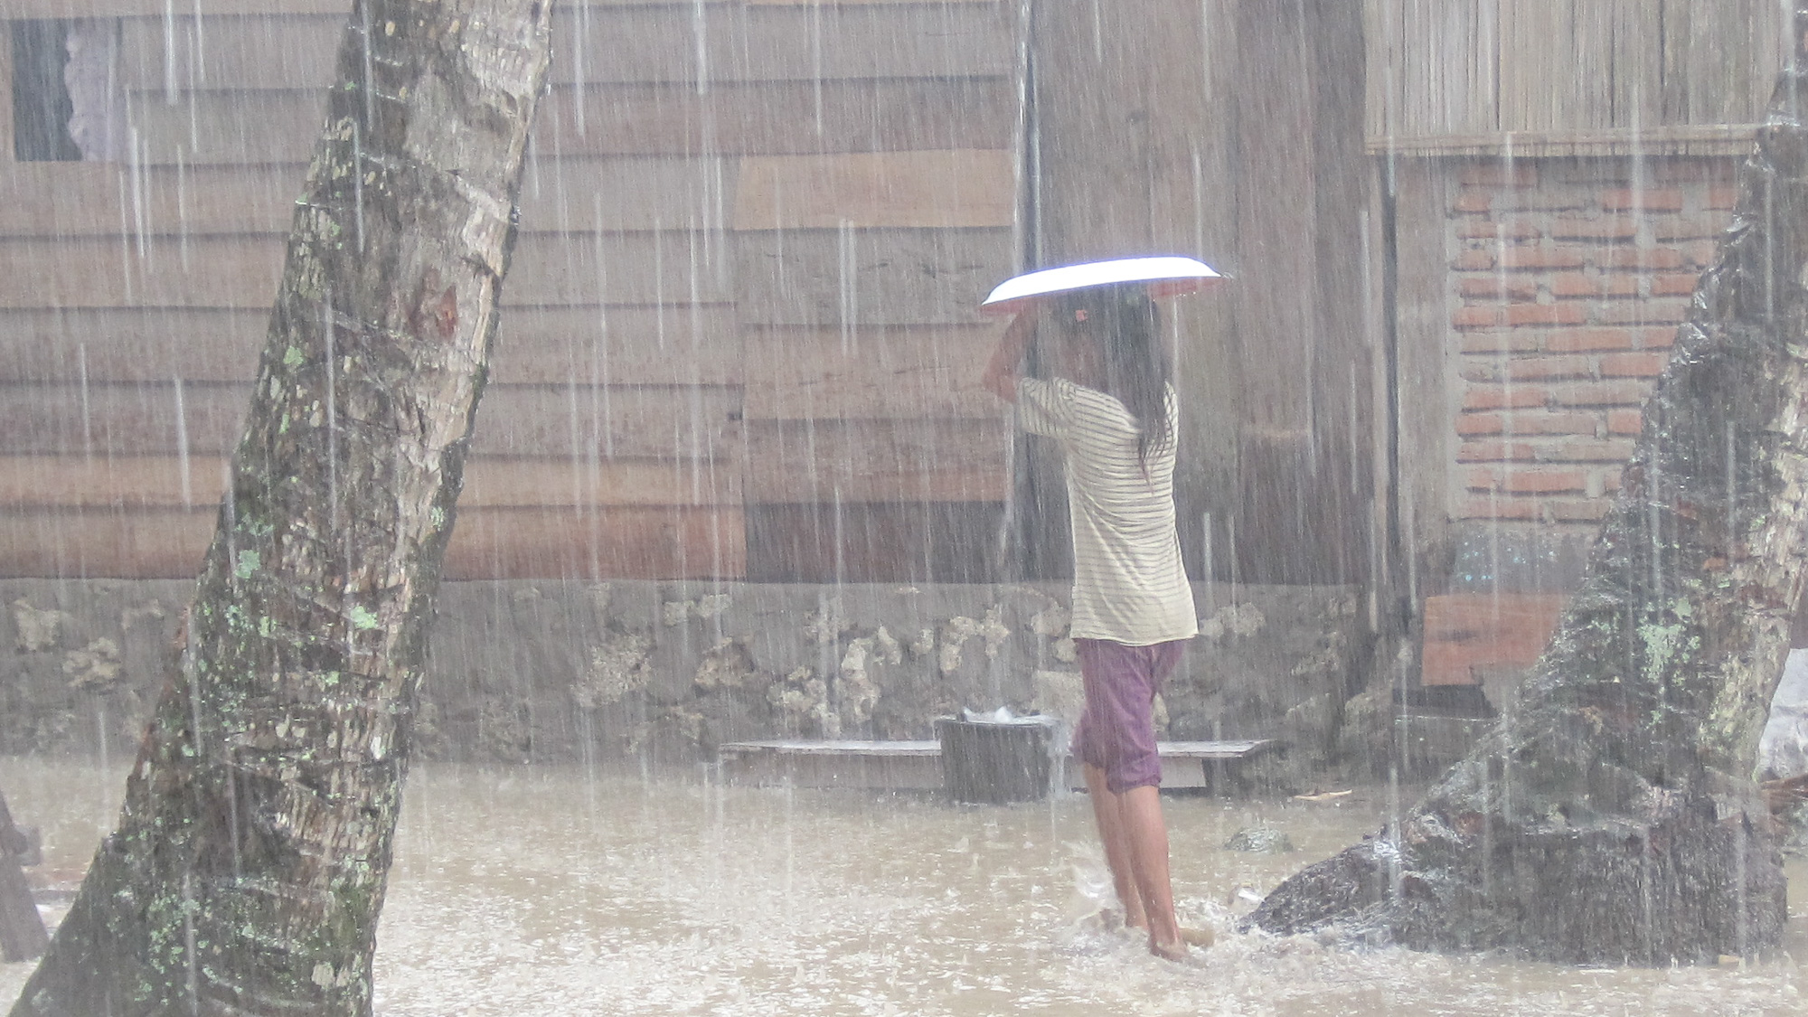
Why engage in adaptation planning?
Governments are making plans and budgets for how to adapt to a changing climate – but there is a risk that the adaptation needs of vulnerable people are not adequately considered
National Societies, with their local experience, are best placed to advocate for adaptation needs of the most vulnerable people
Notes:
Engaging in humanitarian diplomacy may help strategically position National Societies for (influencing) resource mobilization, especially with the new and increasing climate funds coming to governments that need to address the local adaptation priorities of the affected communities.
National Societies, with their experience, are best placed to bring forward the adaptation needs of the most vulnerable.

Slide 24
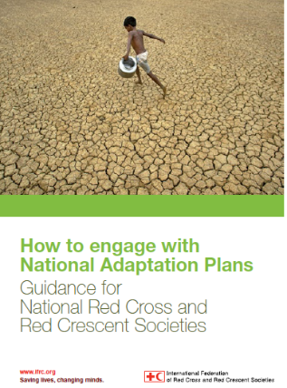
Why engage in adaptation planning?
Check the NDC document for your country (check for opportunities for engagement / contribution)
Check if a National Adaptation Plan (or similar) is available
Compare the NAP and NDC for your country and identify the areas where your National Society can be engaged
Convene stakeholders meetings on the implementation of NDC and NAP
Investigate opportunities to have a seat on committees dedicated to national climate change issues
Engage in mainstreaming disaster risk reduction (DRR) and climate change adaptation (CCA) and access locally available funds for DRR and CCA work
Consistently follow up on the stakeholders meeting outcomes
Notes:
See also separate presentation and exercises in this module.
[Note: a separate set of training material on NPA/NDC is available at http://climatecentre.org/programmes-engagement/national-adaptation-plans]
Find out what has been published in terms of strategies and policies by your government. Within the UNFCCC framework, most of the least developed countries have written a National Adaptation Programmes of Action (NAPA) a few years ago. This was the first generation of national adaptation plans. Since the COP decisions in December 2011, a second generation of “National Adaptation Plans (NAP) plans will be developed and implemented by governments; in addition, the Intended Nationally Determined Commitments (INDCs) will often summarize the formal commitments (reported to UNFCC) and they will/may list relevant adaptation options. Influencing next generation INDCs is a key opportunity for advocacy.
Read through the relevant adaptation policies/INDCS/NAPs etc. of your government and find out whether the humanitarian consequences of climate change are acknowledged and addressed. Look for key words like disaster risk reduction, early warning systems, community based adaptation, most vulnerable people, food security, health, water and sanitation.
Decide whether the humanitarian consequences are sufficiently addressed. You can always contact the Climate Centre for advice.
Most countries submit “National Communications” on climate change to the UNFCCC. Even though the main parts of these reports are about greenhouse-gas emissions (of less relevance for the Red Cross Red Crescent), they also describe the vulnerability of your country to climate change impacts in the coming decades and provide a good background. See also:
http://maindb.unfccc.int/library/view_pdf.pl?url=http://unfccc.int/resource/docs/2011/sbi/eng/l16.pdf
On the UNFCCC website you can find the contact information for national focal points – the ministry where you can find out about the adaptation policy of your government.

Slide 25

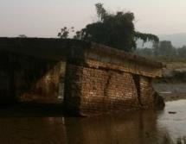



Findings IFRC Disaster Law Programme:
Sectoral laws are equally important to reduce risks
Building codes
Land Use planning
Environment
Climate change adaptation
Development approvals
Mainstreaming climate-smart DRR
Notes:
The sectoral laws that regulate physical planning aspects of development and settlements, including building codes, land use regulations, environmental management and climate change laws are really the pillars of DRM – as they address underlying vulnerability in both urban and rural areas.
One of the biggest challenges we found in our research in implementing building codes and land use planning regulations, ist that the all require local government implementation – and local governments rarely have the capacity or resources to oversee effective implementation.
There is also a clear lack of ‘compliance culture’ in many lower and middle-income countries – which calls for further training and awareness raising.
Another prominent finding was that there is a clear need to have better coordination between these sectoral laws and the DRM laws and systems. Building codes and land use planning generally lack any reference to disaster risk reduction considerations – though we did find some positive examples such as India, where clear links are made between in the frameworks.

Slide 26
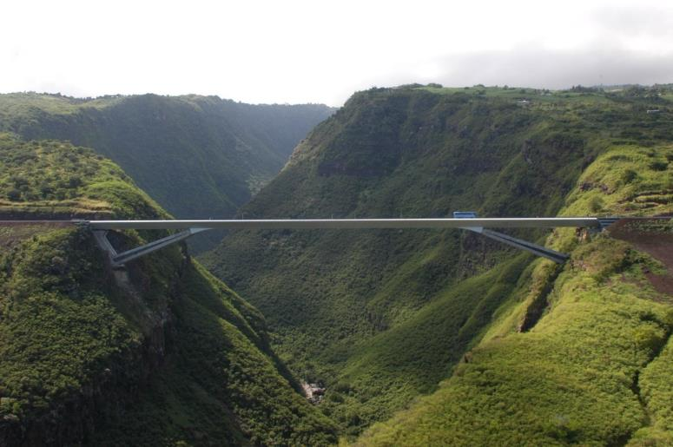
Findings IFRC Disaster Law Programme:
Managed by different institutions and legislation to environment, climate change, water resource management, etc.
Clear opportunity for:
  Including DRR in EIAs
  Eco-DRR approaches
  Integrated water resource management legislation
Environment and disaster divide

Slide 27
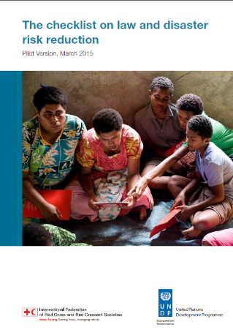
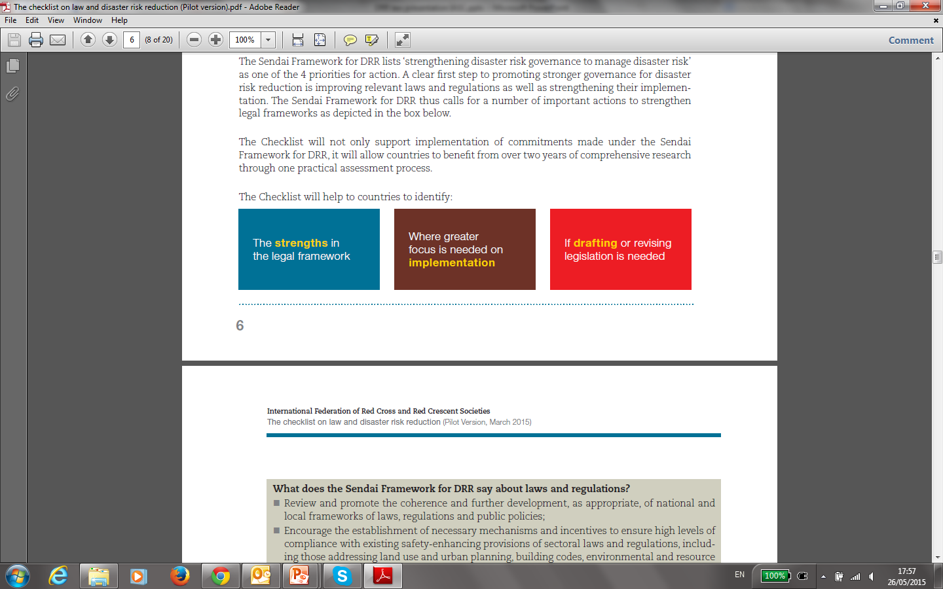
The Checklist on Law and (climate-smart) DRR
Draws on key findings of the multi-country study and 3 years of consultations at the country, regional and global level
Designed to guide a review or assessment process of laws and regulations for DRR
States encouraged to use it by the 32nd International Conference

Slide 28
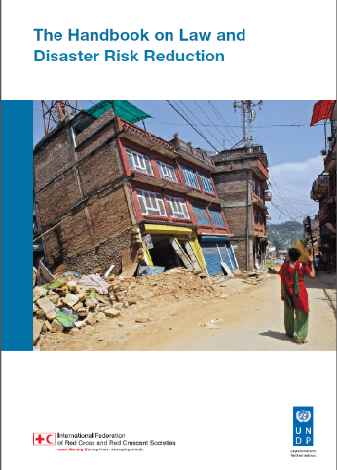
The Handbook on Law and Disaster Risk Reduction
The Handbook provides guidance on how to use the Checklist. For each Checklist question it sets out:
  An explanation and rationale
  Issues that need to be considered to properly address and answer the question
  Examples of good practice from different countries
  It provides suggested steps on undertaking a legislative review process, drawing from country experience

Slide 29
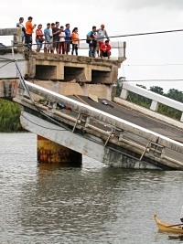
Key gaps and challenges
Decentralized implementation
  Local government responsibility but lacks means
Funding mandates
  Even DRM funds tend to favour response
Accountability
  Few mechanisms for monitoring & oversight
Early warning & risk mapping
  Lack of clear direction on EWS
Source: IFRC Disaster Law Programme

Slide 30
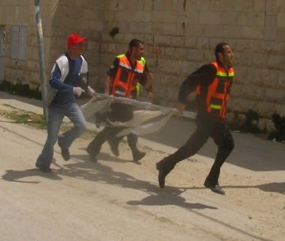
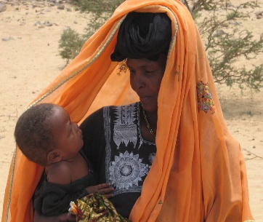
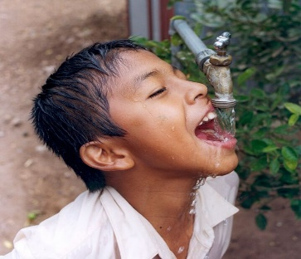
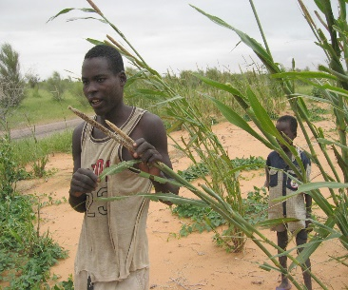
Remember, our messages to governments are closely related to what we already do…
Disaster management, DRR, Resilience
“People First”
Health & Care
Climate (change) risks
Water, Sanitation and Hygiene
Food Security and Social Protection
etc.
Notes:
Climate change risks cut across sectors and will have to be dealt with across sectors. This is not only challenging within the Red Cross Red Crescent Movement but for governments too. It is always smart in the Red Cross Red Crescent to start thinking about how to integrate the implications of climate change and climate risk management across different programmes and departments.
DRR is identified as a main element of climate change adaptation. This means there is huge overlap between what we consider to be climate change adaptation and DRR. Within the Red Cross Red Crescent we already have the experience to work in strengthening community resilience, with health, water and sanitation, as well as programmes on disaster preparedness and the mitigation of disasters. Therefore climate change adaptation is nothing new to us; only project design is slightly different.
If you have no practical example to show to your government on Climate-smart DRR, you can easily demonstrate experience from one of your neighboring National Societies that can help you to make the case.

Slide 31
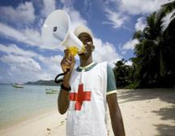
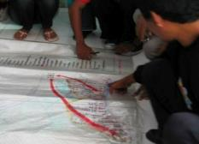
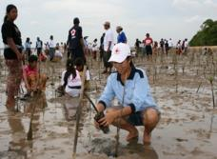
Much of what National Societies already do, can set an example to your government on local adaptation in practice…
Climate-smart disaster risk reduction = adaptation
Notes:
Dialogues on DM Policies are happening abundantly. Moreover, National Societies are often seen as the ‘to-go’ partner for development and implementation of DM or DRR policies. This presentation is intended to show that it is a most logical step for National Societies to engage in both DRR and Adaptation dialogues, to ensure Climate-smart DRR is a prominent feature of the NAP and very similar policy asks are available for both dialogue processes.

Slide 32
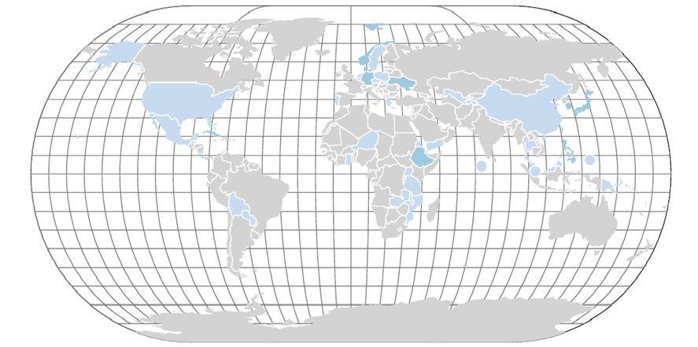
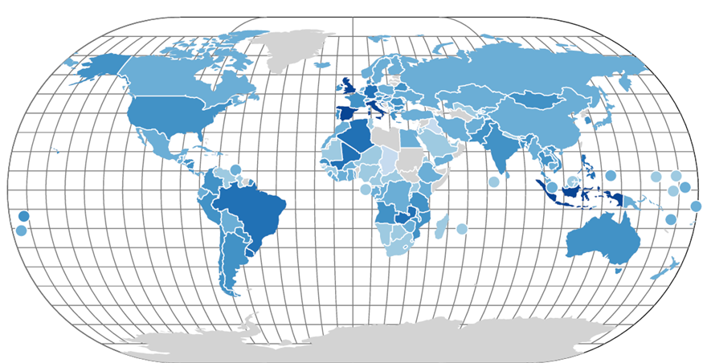
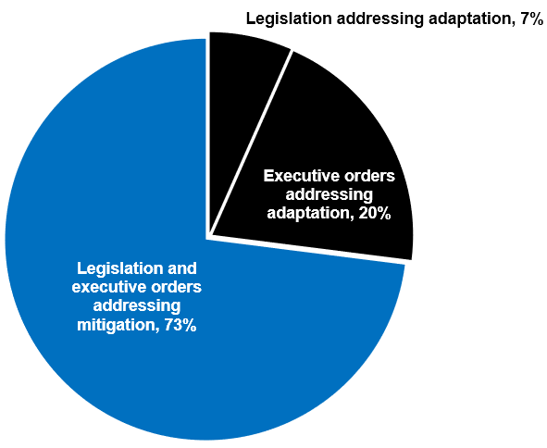
Climate legislation 1997:
70 laws and policies in 177 countries
Climate in legislation
Climate legislation 2018:
1500 laws and policies globally
Source: Grantham research institute on climate change and the environment
But adaptation is under-legislated…
Notes:
[Can the DRR Law team add more here on why this is important?]

